Slide 1
Monthly Report French Bakery A
January 2021
Ribka Natalia

Slide 2
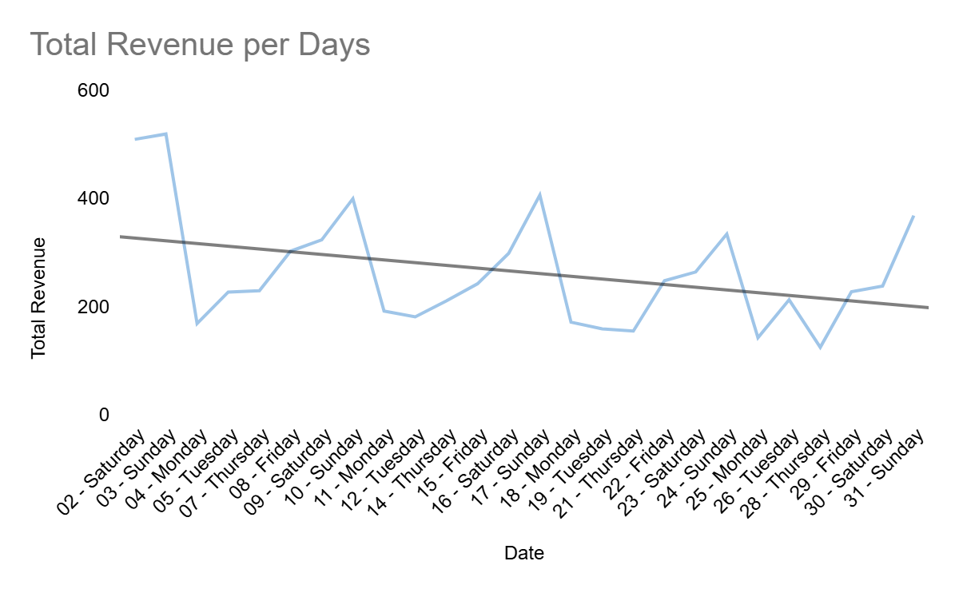
Background
Sales is inconsistent and slowly go down
French Bakery A's overall sales are showing a negative downward trend. This indicates that our sales have shrunk this month.
This outcome is inconsistent because sometimes we have high sales, but other times we lose demand in the market.
This factor can make it difficult to stay sustainably in the long term.

Slide 3
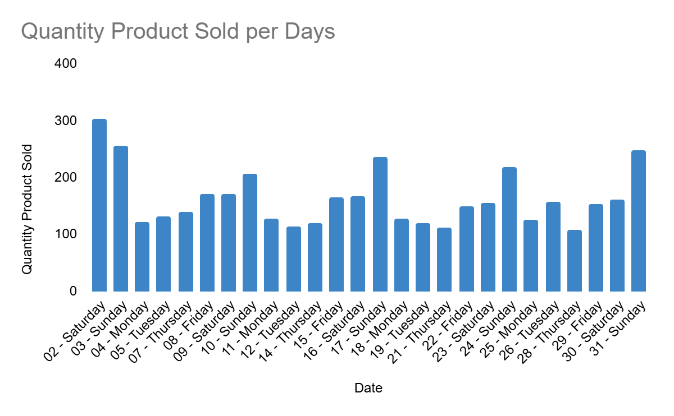
Review : Weekends are the busiest days in bakary
Only on the weekend do we get the highest order in the month.
For better production balance, the bakery needs to increase output on weekends and decrease it on weekdays.

Slide 4
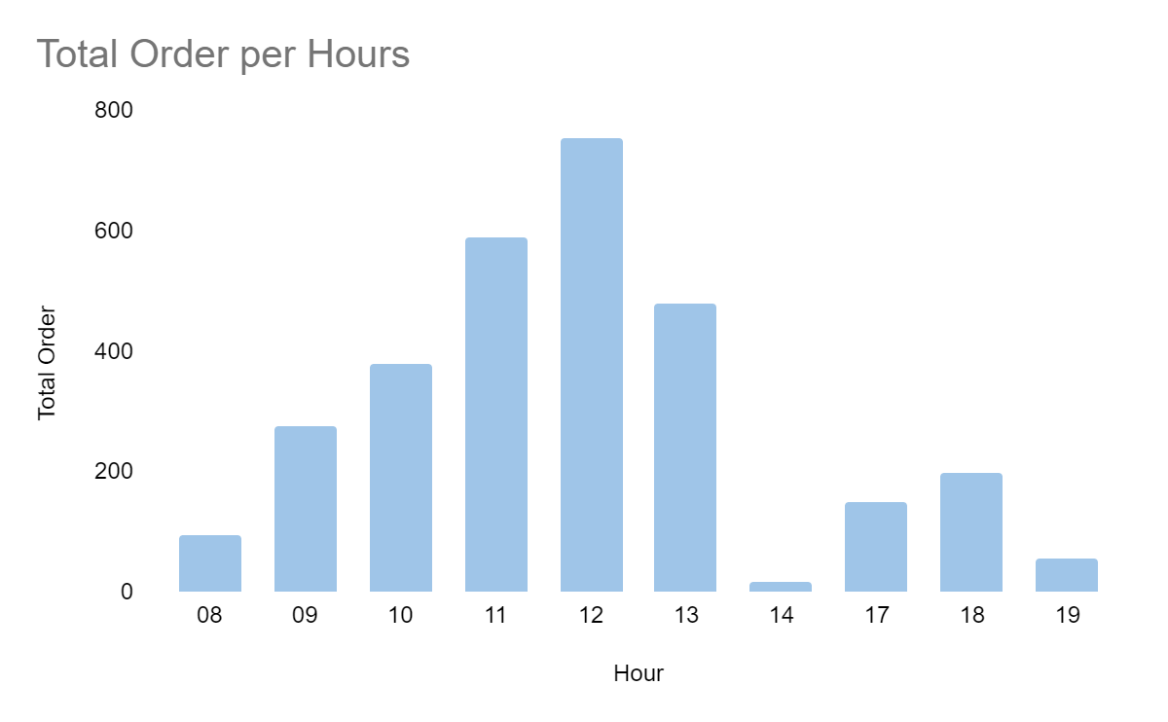
Review : Lunchtime is our busiest time
The bakery is the crowdest at 12:00 (around Lunchtime).
The bakery needs to increase production before lunchtime and stop at 13:00, as sales are less in demand from 14:00 to 19:00.

Slide 5
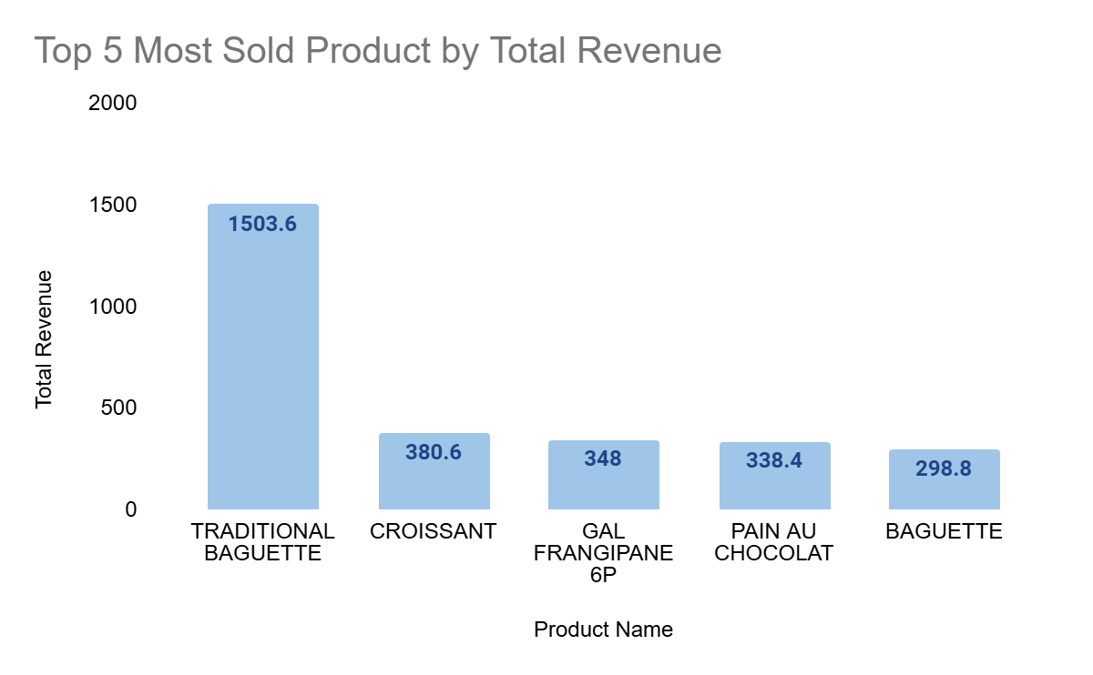
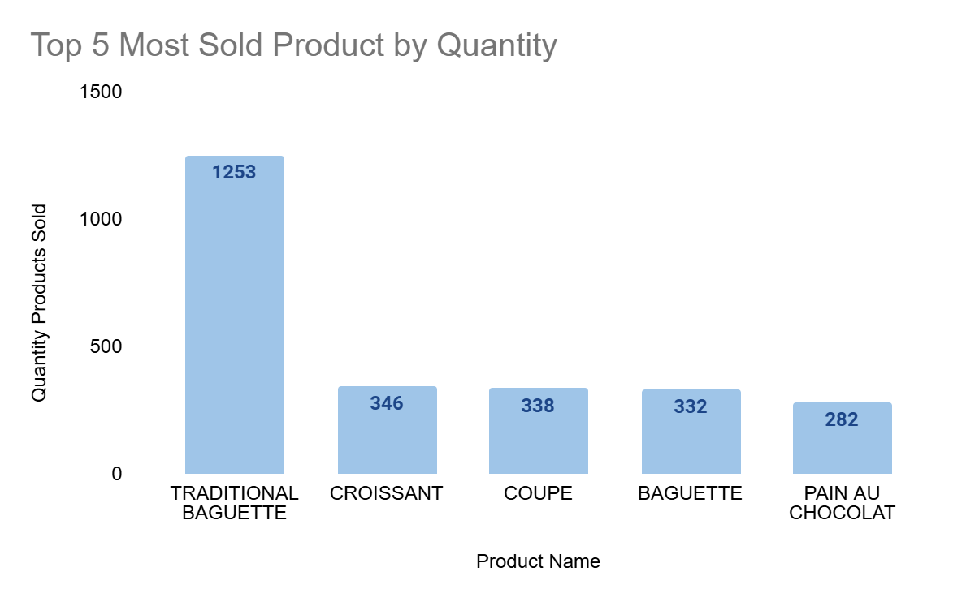
Top 5 Most Sold Bread
Traditional Baguette is the most popular bread for consumers.
To reduce food waste, prioritize the production of the top 5 most popular breads over other types.

Slide 6
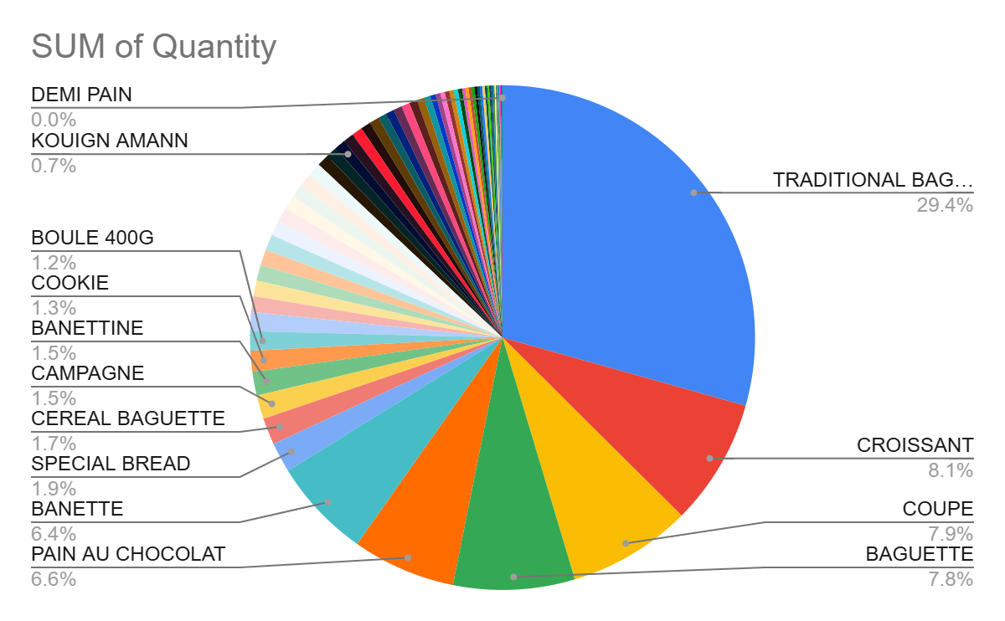
Review : which type of Bread should we keep selling or not
In our data, there are 70 type of Bread that we sell in our Bakary. However, more than half of the types of bread have a sales quantity of less than 1%.
We should consider reducing the variety of bread we make daily to minimize waste.

Slide 7
Recommendation
Focus on High-Demand Product : the most sold Bread like baguette traditional should be produce and promoted more as they are more demand with customers.
Time Production : produce more bread during weekends and in the hours before lunch.
Review several product types: Stop producing bread types that are not popular amongcustomers. Consider selling them seasonally.

